Slide 1


Slide 2

NumPy and Matplotlib introduction

Slide 3
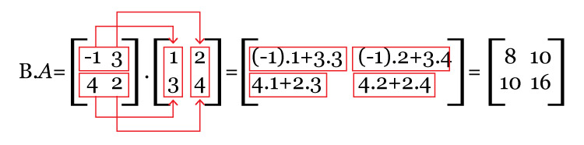
Why Numpy?
NumPy is the fundamental package needed for scientific computing with Python
Numpy Features:
Typed multidimensional arrays (vector, matrices)
Fast numerical computations (matrix math)
High-level math functions
Open Source
Project done in years
0
1
1 | 3 | 5
1 | 1 | 1
0
1
4.5 | 4 | 5
4.3 | 4.4 | 4.6
Employee
Notas

Slide 4
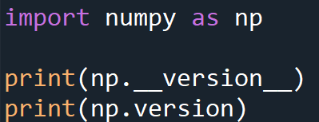
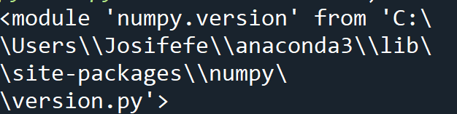
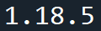
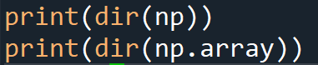
Output
Output
# show all available methods to manipulate np and np. array respectively

Slide 5
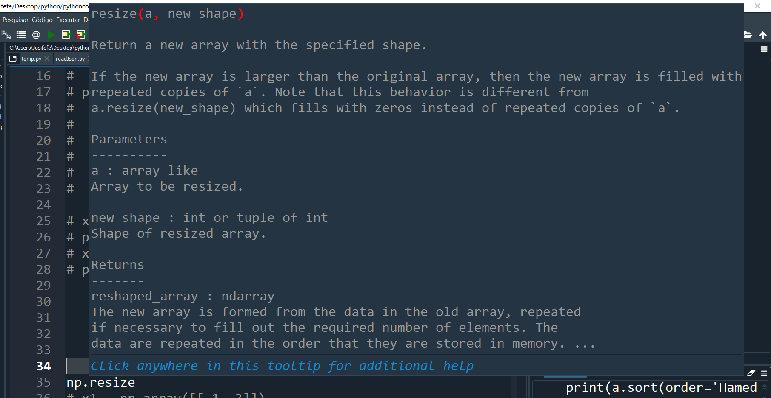
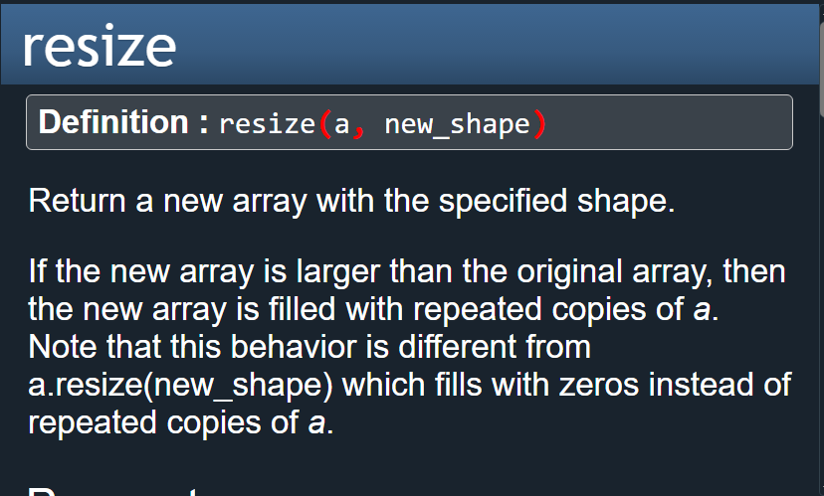
Getting help:
Ctrl-I

Slide 6
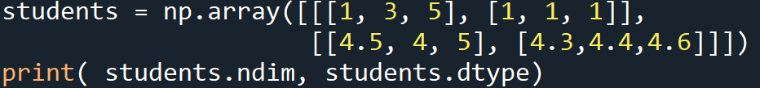
Arrays are a homogeneous collection of exactly the same data-type
Arrays can have any number of dimensions, including zero (a scalar).
Arrays are typed: np.uint8, np.int64, np.float32, np.float64
Array Attributes:
students.shape #(2, 2, 3) 2 blocks, 2 lines, 3 elements
students.nbytes # 12 shape *itemsize
students.ndim # 3 dimension
students.dtype # int8 data type
students.size # 12 elements
students.data #<memory at 0x00000210E597B5E0> memory location
students.itemsize #1

Slide 7
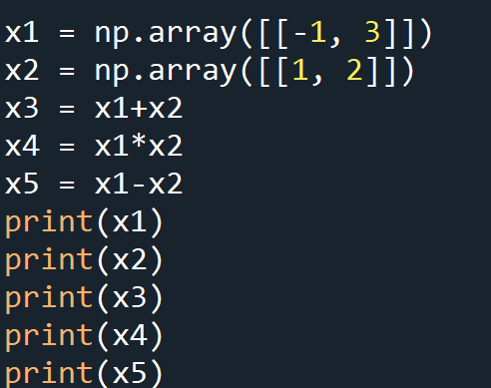
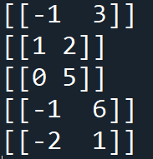
Arithmetic operators: elementwise application
Output

Slide 8
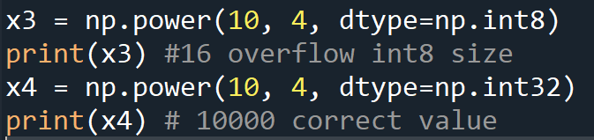
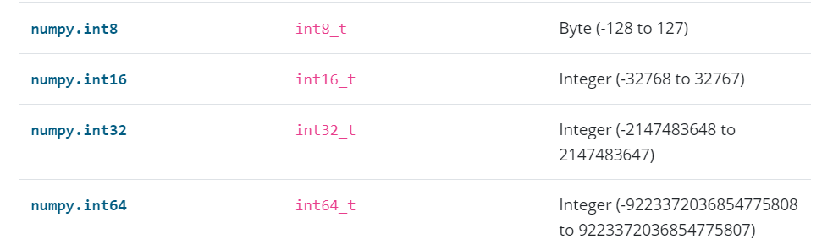
Be careful with data types
https://numpy.org/devdocs/user/basics.types.html

Slide 9
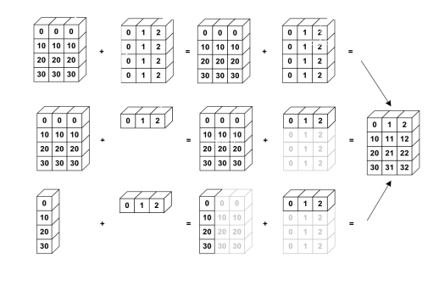
Array broadcasting
https://numpy.org/doc/stable/user/basics.broadcasting.html#:~:text=The%20term%20broadcasting%20describes%20how,that%20they%20have%20compatible%20shapes.

Slide 10
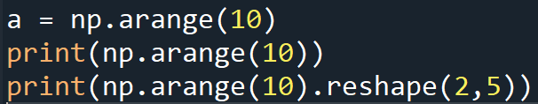
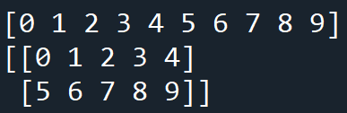
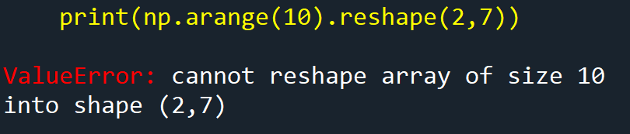
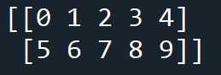
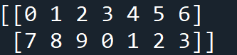
Reshape Vs Resize
Reshape using reshape. Total size must remain the same

Slide 11
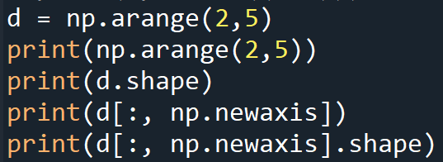
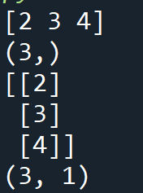
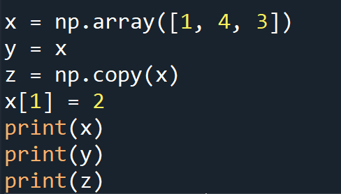
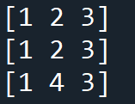
Newaxis : adds a colum in the array
Copy : copy the array to other array
Output
Output

Slide 12
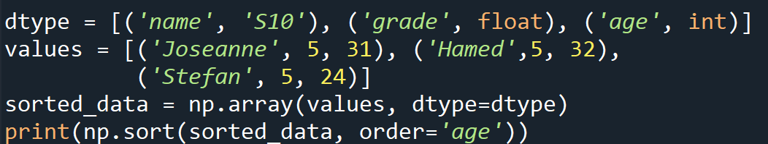
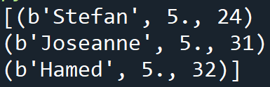
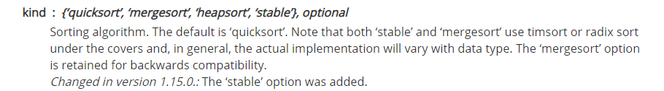
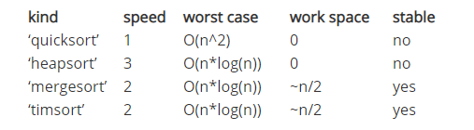
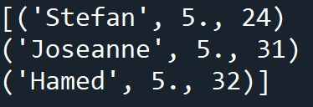
Sorting : organizing a array using a specific parameter
Output
Why b is here?
https://numpy.org/doc/stable/reference/arrays.dtypes.html
How to fix that?
Output

Slide 13
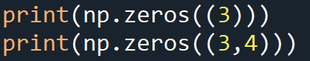
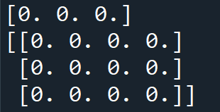
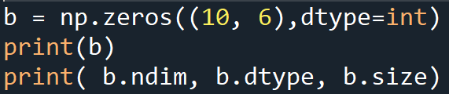
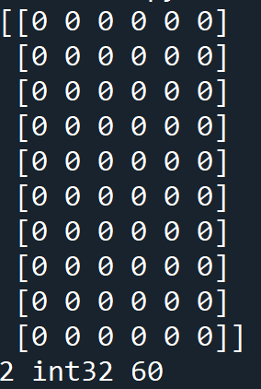
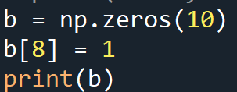
Creating Zeros vectors and Matrices

Slide 14
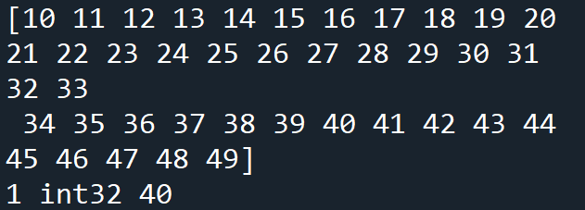
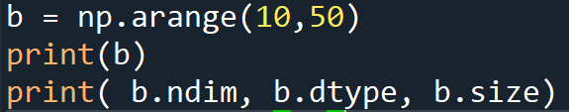
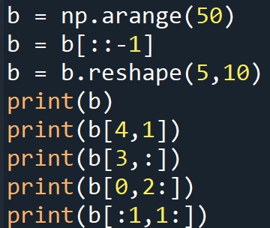
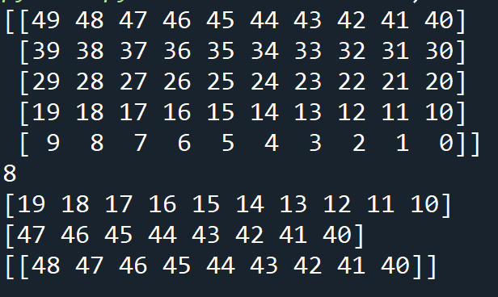
Slicing arrays is almost the same as slicing lists, except you can specify multiple dimensions
Output
Output

Slide 15
x[0,0] # top-left element
x[0,-1] # first row, last column
x[0,:] # first row (many entries)
x[:,0] # first column (many entries)
Notes:
Zero-indexing
Multi-dimensional indices are comma-separated (i.e., a tuple)
Writing to a slice overwrites the original array

Slide 16
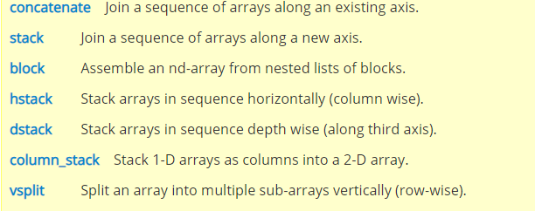
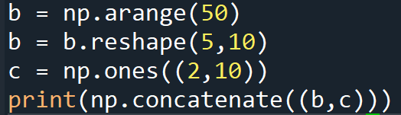
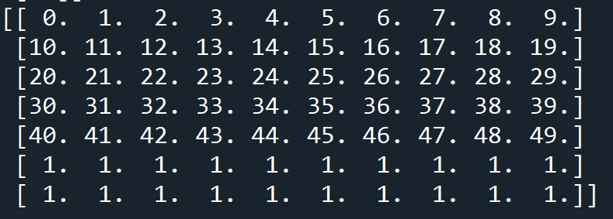
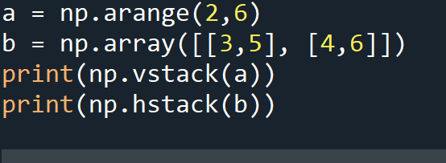
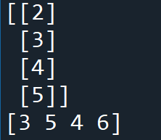
Concatenation, vstack, hstack
Output
Output

Slide 17
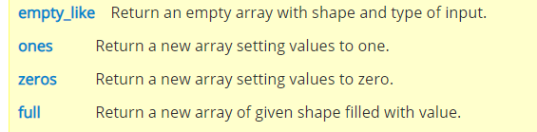
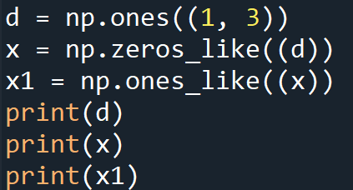
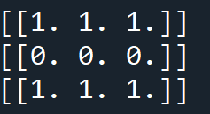
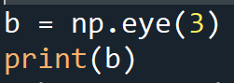
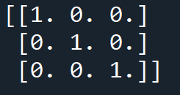
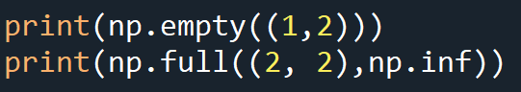
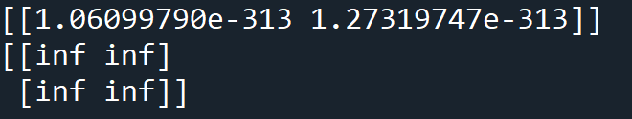
Ones,, zeros_like, ones_like, eye, empty, full

Slide 18
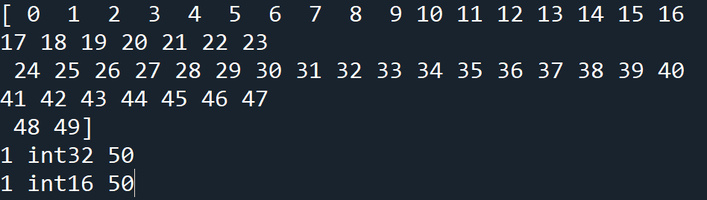
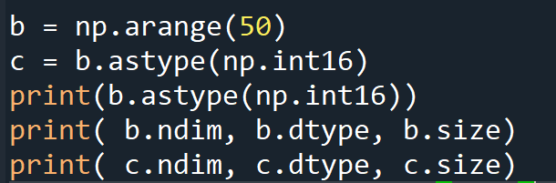
Astype
Output

Slide 19



Random Numbers

Slide 20





Usefull funcionality

Slide 21


Slide 22

Imaging Processing
https://pillow.readthedocs.io/en/stable/handbook/concepts.html#concept-modes

Slide 23


